Slide 1
EECS E6895 - Milestone 2 A-share Stock Auto Trader
B9: Investment Strategy - AI Trader (CN/HK/TW/JP)
Yiwen Fang (yf2560) | Guoshiwen Han (gh2567)

Slide 2
Data Collection & Procession
Model Training Method
Coding Work
Timeline
Q & A

Slide 3
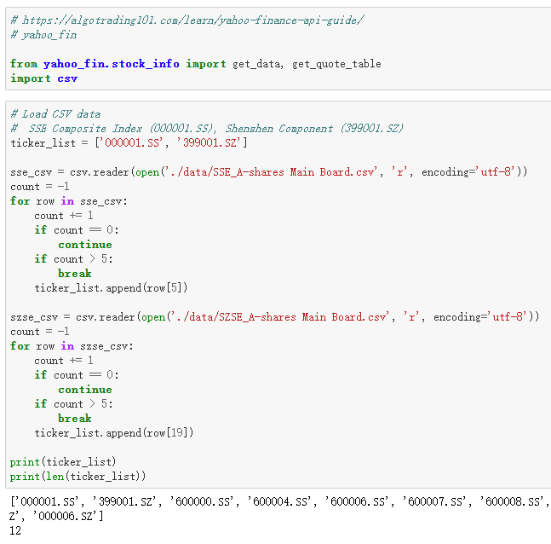
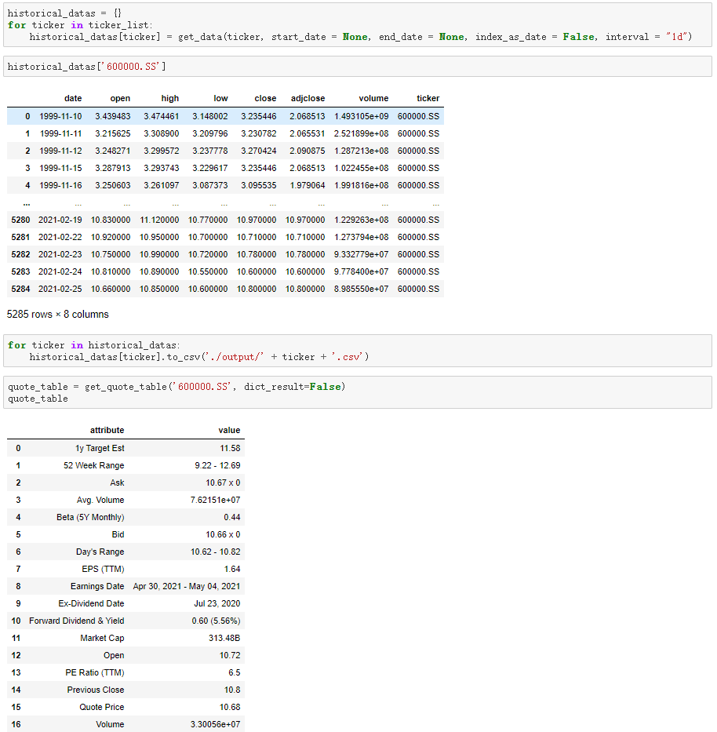
Data Sources and APIs 2000+ A-share main board stock in Shanghai/Shenzhen Stock Exchange, API is yahoo_fin which extracts stock info from Yahoo Finance
Data Sources
APIs
Shanghai Stock Exchange: 1500 + A-share main board stock
Shenzhen Stock Exchange: 500 + A-share main board stock
Yahoo Finance: Finance info including Open-High-Low-Close (OHLC)
yahoo_fin is a Python library
Limited thousands of calls per month
Each stock attributes including date, open, high, low, close, adjclose, volume
Collect the daily exchange data from the first listed day to today

Slide 4
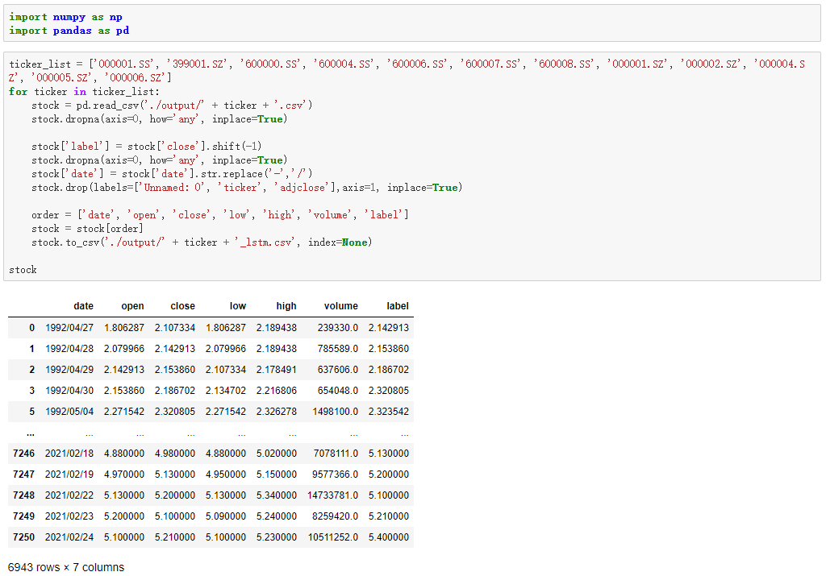
Data Cleaning and Mutations Eliminate any rows with empty/NA values, add a “label” column, which is the value of the next day, as the predicted value

Slide 5
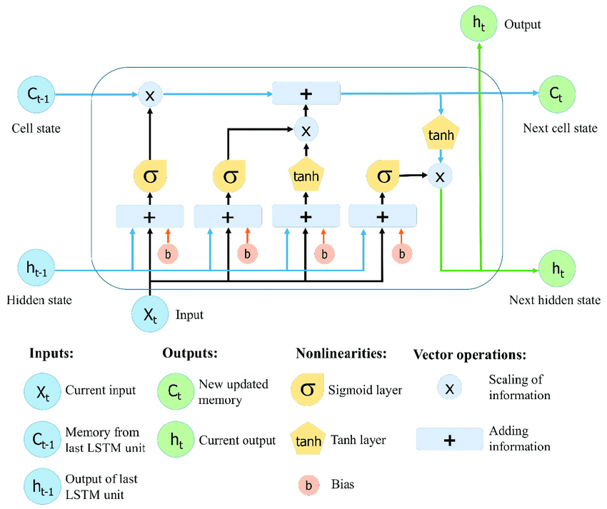
Model Training Method LSTM (Long Short-Term Memory)
Stock forecasts are highly non-linear
The forecasting model should be able to deal with non-linear problems
Stocks have the characteristics of time series
Cyclic neural networks are suitable to predict stocks
Source: https://www.mdpi.com/2073-4441/11/7/1387

Slide 6
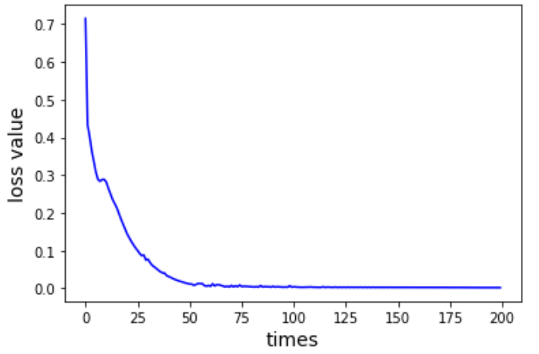

Coding Work
with tf.Session() as sess: # initialization sess.run(tf.global_variables_initializer()) theloss = [] # Number of iterations for i in range(200): for step in range(len(batch_index) - 1): # sess.run(b, feed_dict = replace_dict) state_, loss_ = sess.run([train_op, loss], feed_dict={ X: train_x[batch_index[step]:batch_index[step + 1]], Y: train_y[batch_index[step]:batch_index[step + 1]], keep_prob: 0.5}) print("Number of iterations:", i, " loss:", loss_) theloss.append(loss_)
loss function:
$$MSE=\frac{1}{n}\sum_{i=1}^{n}{{(y_{i}− {\tilde{y}}_{i})}^{2}}$$

Slide 7
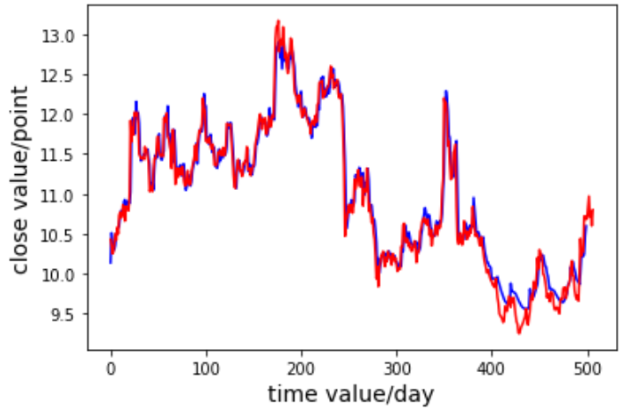
Coding Work
with tf.Session() as sess: saver = tf.train.import_meta_graph('model_save2//model.ckpt.meta') saver.restore(sess, "model_save2//model.ckpt") # module_file = tf.train.latest_checkpoint('model_save2//model.ckpt') # saver.restore(sess, module_file) test_predict = [] for step in range(len(test_x) - 1): predict = sess.run(pred, feed_dict={X: [test_x[step]], keep_prob: 1}) predict = predict.reshape((-1)) test_predict.extend(predict)
prediction: predicted – blue | real - red

Slide 8
Timeline Milestones 2 has been finished, we are working on Milestones 3
Milestones 2
Milestones 3
Final Project
Switch from A11 Reasoning to B9 AI Trader
Data collection and procession for OHLC of 2000+ stocks via Python and yahoo_fin API
Determine the training method of the model: LSTM model for stock price forecasting
LSTM model obtained and prediction made successfully
Codes showed
Model training evaluation and tuning
Three pages of frontend coding
Make app assembled of both frontend and backend
Update data and model automatically per day
Extend the result to other factors such as macroeconomic indicators and company financial reporting indicators
Deployment to the cloud

Slide 9
Q&A

